Slide 1
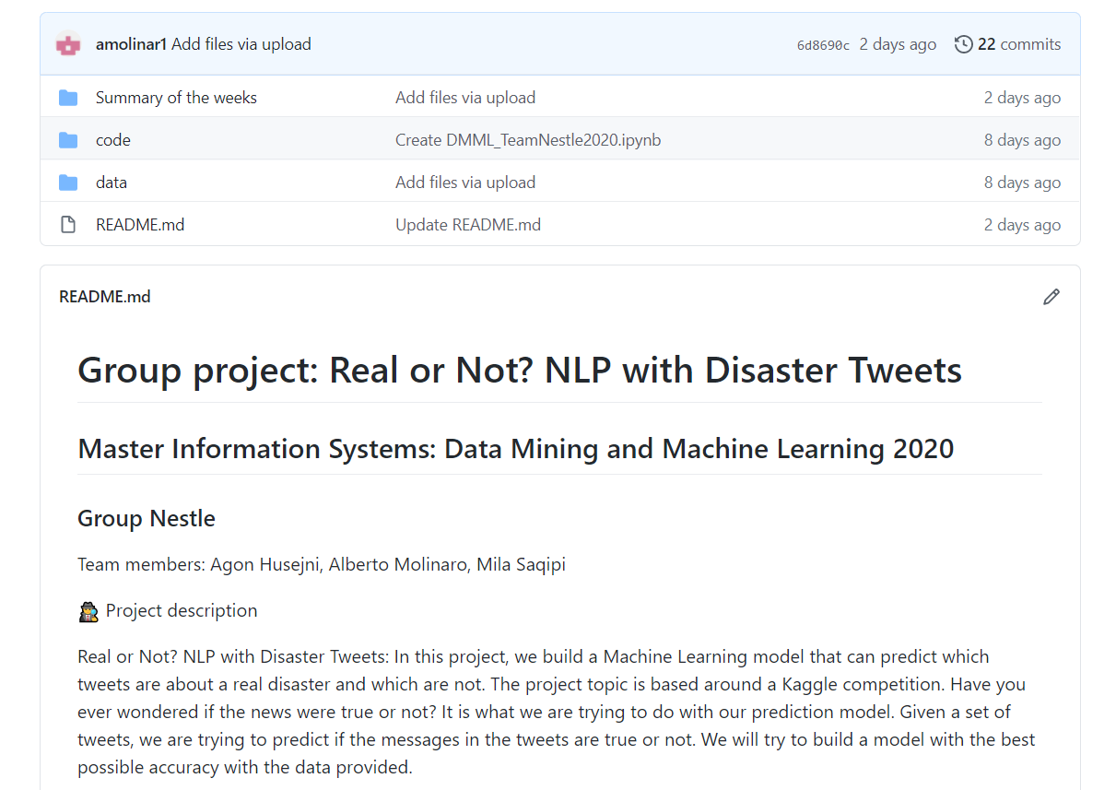
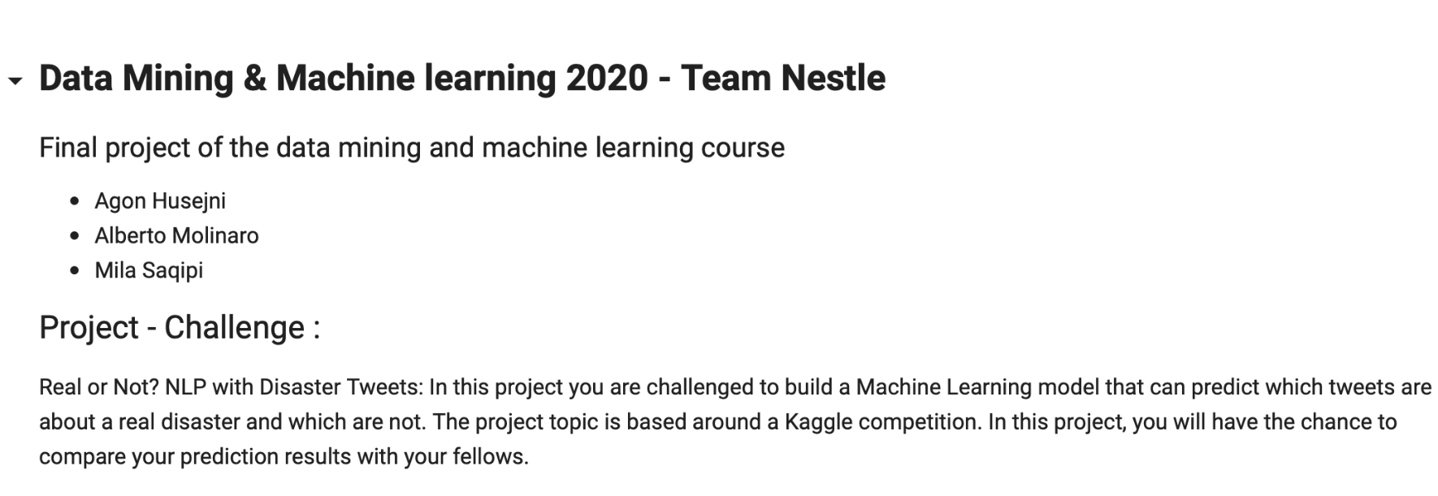
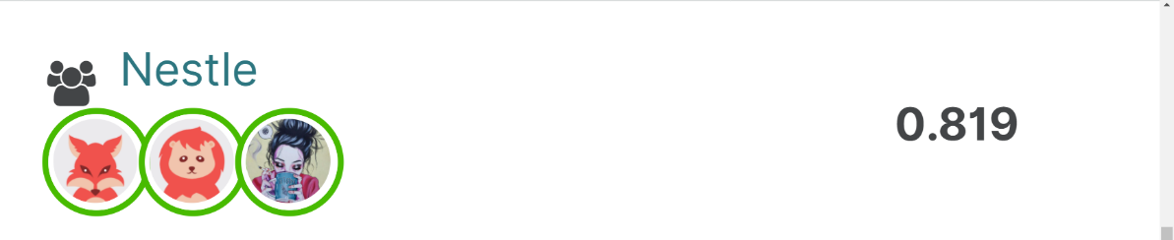
DATA MINING AND MACHINE LEARNING
SUMMARY OF THE WEEK 3
Final project
Task performed
DATA CLEANING TECHNIQUES
TRYING SEVERAL CLASSIFIER
THIRD SUBMISSION –IMPROVEMENT
TEAM NESTLE
Agon Husejni, Alberto Molinaro, Mila Saqipi

